Slide 1
Welcome to the our project
Topic : Build a responsive Expense Tracker
Team members:
Khan Mohammed Kaif, Ansari Mohammed Ayaan

Slide 2
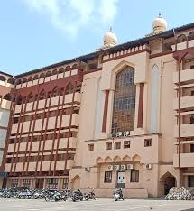
Expense Tracker
Team members: Khan Mohammed Kaif, Ansari Ayaan
Course / Subject name: ITR(315002)
College name: M.H. Saboo Siddik Polytechnic
Date: 23-09-2025

Slide 3
1. Introduction
Q. What is Expense Tracker?
Ans: An Expense Tracker is a digital tool that helps users record, categorize, and analyze their daily, weekly, and monthly expenses.
Q. Why Is it important?
Ans:
Many people struggle to track where their money goes.
Manual tracking is time-consuming and error-prone.
Lack of expense analysis leads to overspending and poor savings habits.
Our project goal:
To create a simple, user-friendly expense tracking solution that helps users manage finances, stay within budget, and make better financial decisions

Slide 4
2. Objectives of our project
Our project Aims to:
Secure login and register: You can register and Login securely communicated.
Simplify expense tracking: Allow users to quickly record daily expenses.
Generate Insights: Show visual charts for analysis.
Ensure Data Safety: Store expense data securely and reliable.

Slide 5
2. Existing Problem
Common Issues people face in Managing expenses:
Manual Tracking: Writing expenses in notebooks or spreadsheets is time-consuming and prone to errors.
Lack of Categorization: Difficult to know how much is spent on food, travel, bills, etc.
Data loss: Paper records can get lost, and spreadsheets may not be backed up.
No reminders: People forget to track expenses regularly, leading to incomplete data.
No Spending Insights: Users can’t analyze monthl/weekly trends to control overspending.

Slide 6
3. Proposed Solution
Our Expense Tracker Provides:
Easy register and login : You can register and login in a secure way.
Easy expense entry: Quick add, edit, and delete options for daily spending.
Automated reports: Every income or expense can give pie charts for better understanding.
Data backup: Secure storage to avoid data loss.
User-friendly interface: Simple design for fast navigation and smooth experience.

Slide 7
4. Process flow
Step by Step Workflow:
User login / signup: Securely login to access personal expense data.
Add expense: Enter amount, category, date and description.
Store data: Data saved in database securely.
Process & categorize: App automatically organizes expenses by category.
Generate reports: Summary with charts.
View & analyze: User can check spending trends and control ecpenses.

Slide 8
5. Features
Add/Edit/Delete expenses: Manage spending records easily.
Expense categorization: Food, travel, bills, shopping, etc.
Visual charts: Pir charts for their income and expenses.
User-friendly Interface: Simple and clean design for all users.
Responsive Design: Works on mobile and desktop devices.
Secure data storage: Keep data safe and backed up.

Slide 9
6. Technology Stack
Technology used:
Frontend: HTML, CSS, JavaScript.
Backend: JavaScript, Node.js, MongoDB.
Database: MongoDB Altas.

Slide 10
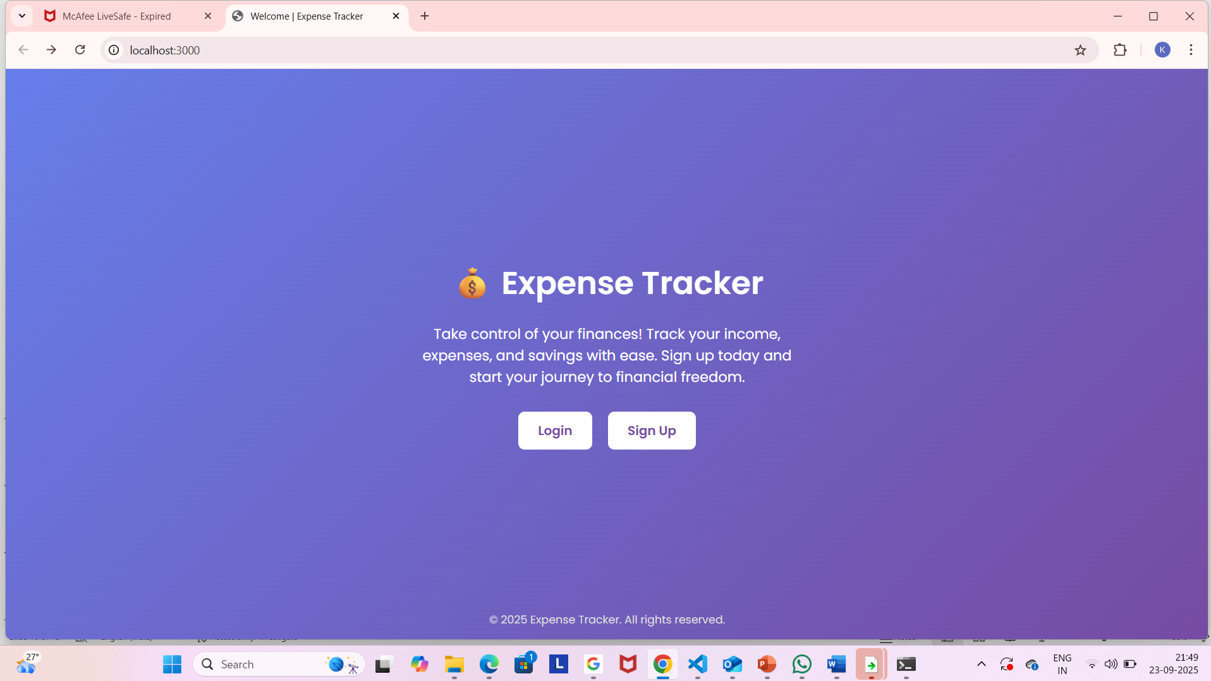
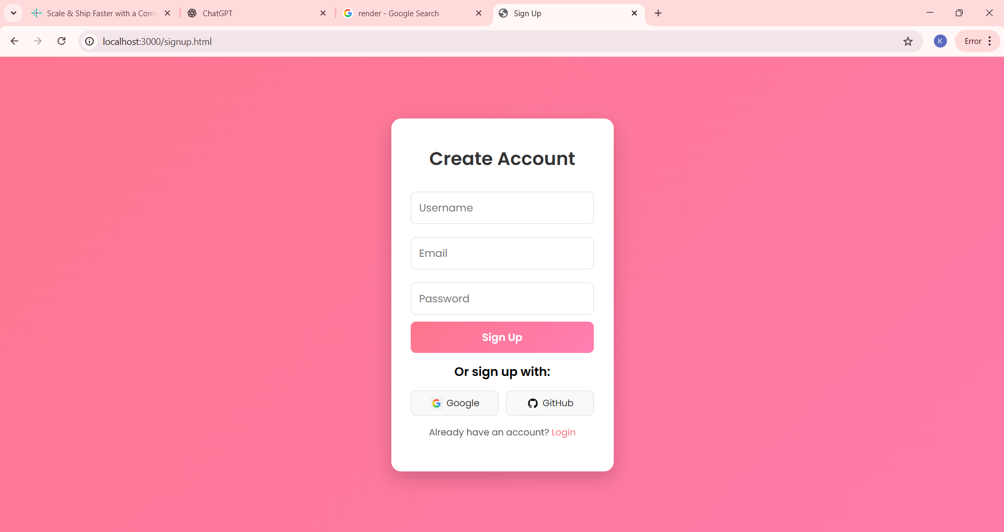
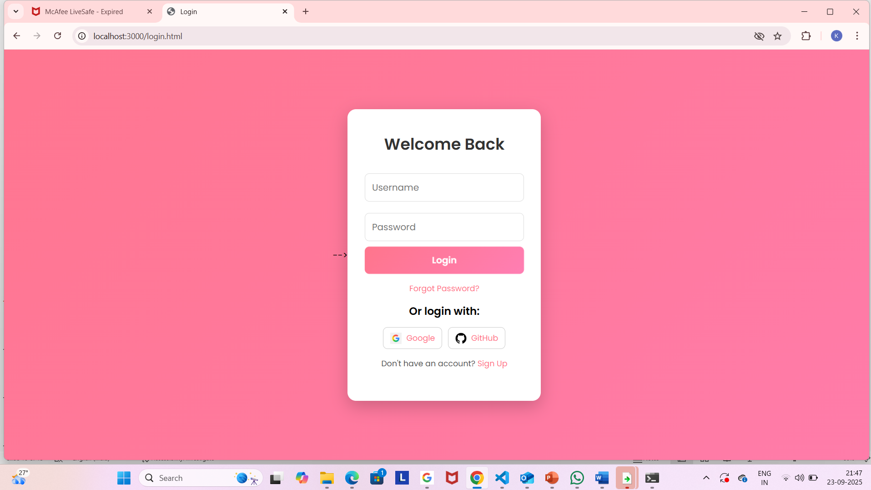
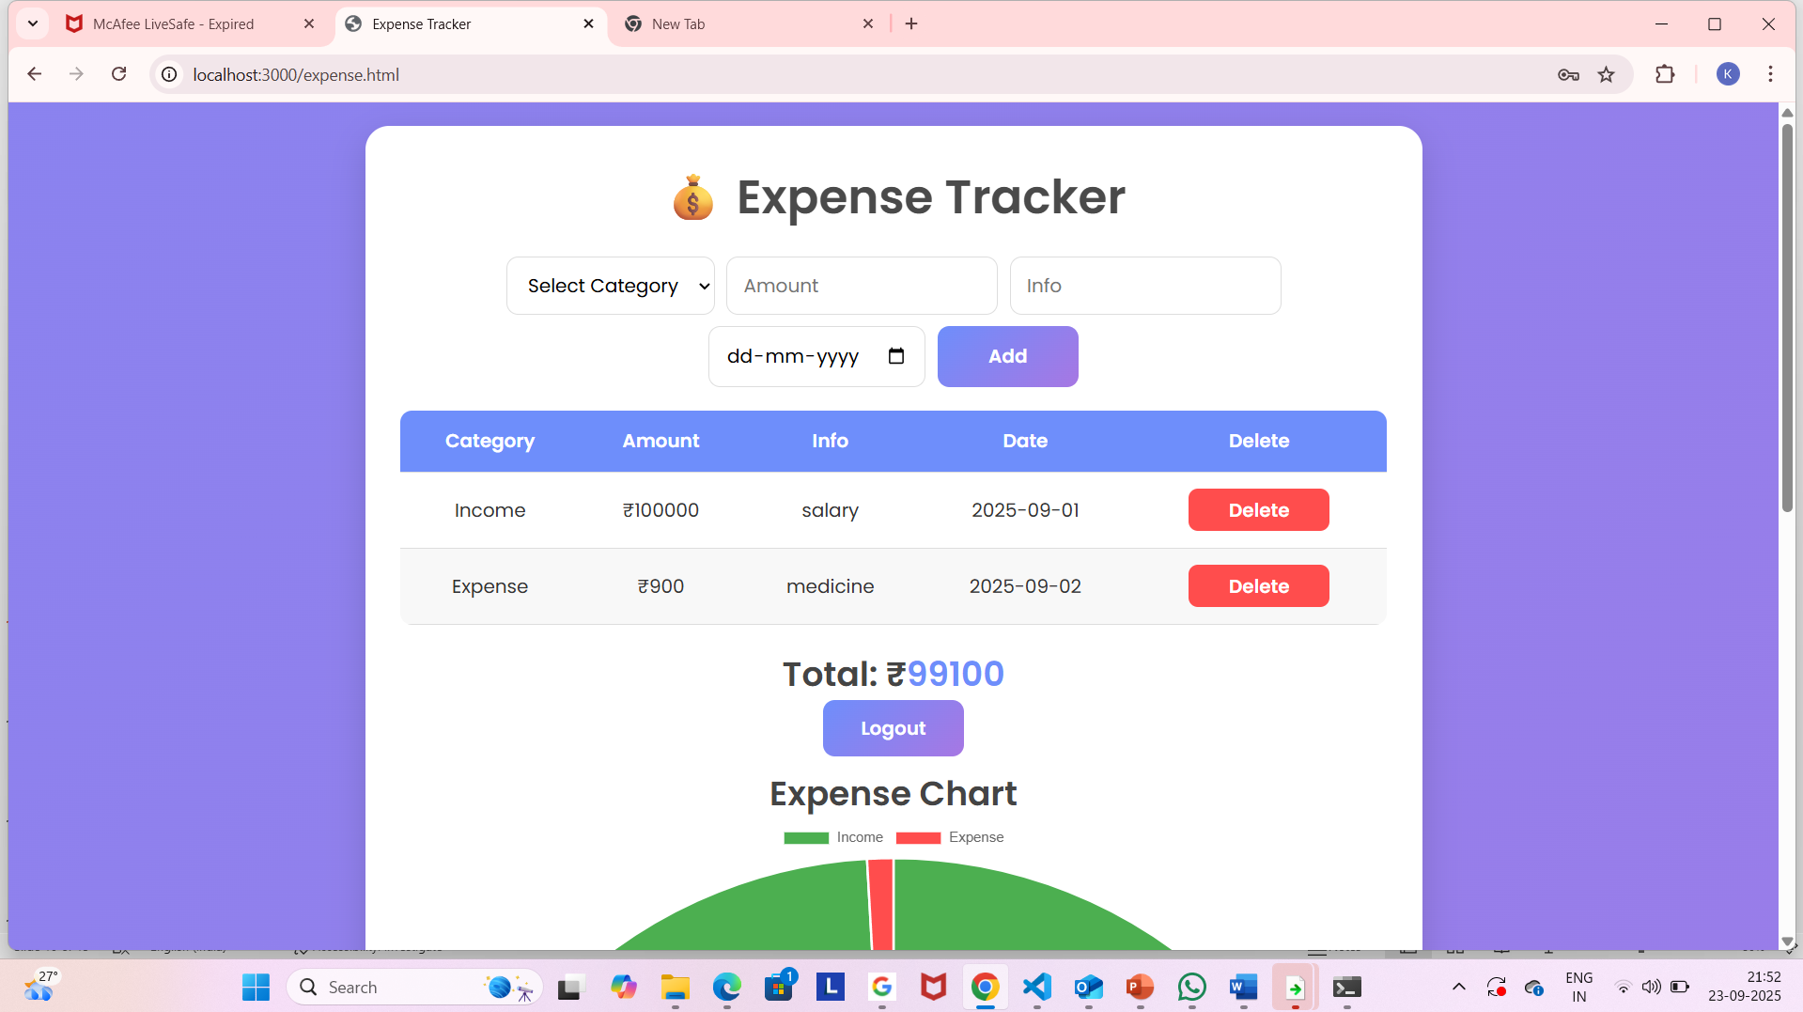
7. UI/UX design

Slide 11
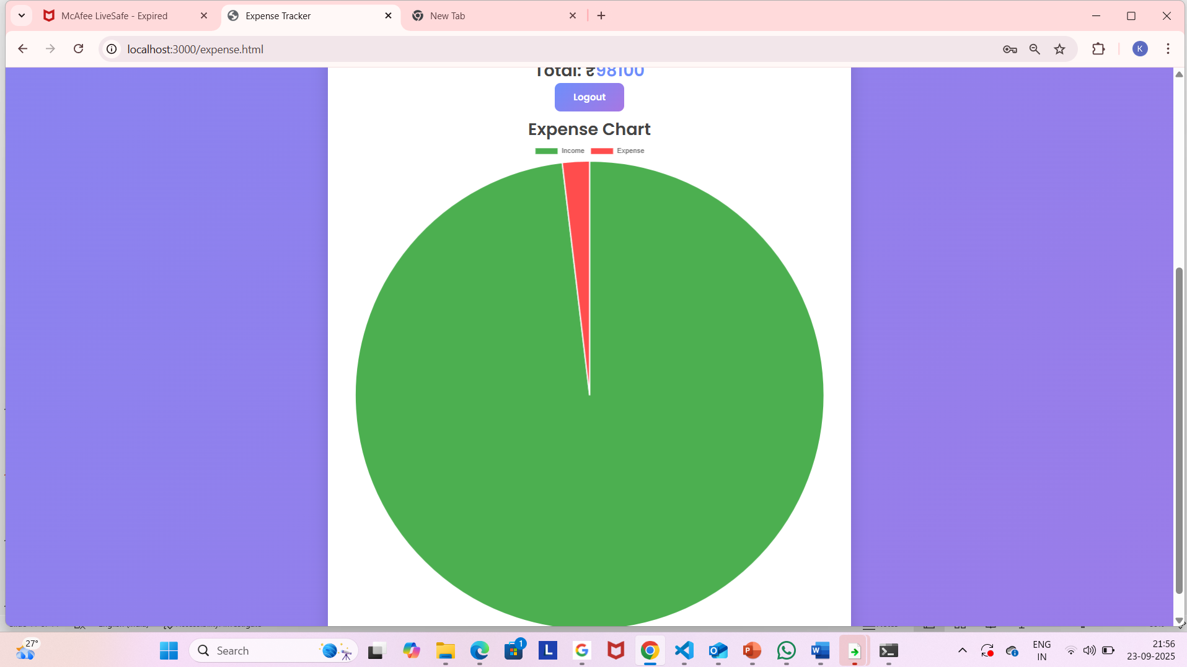
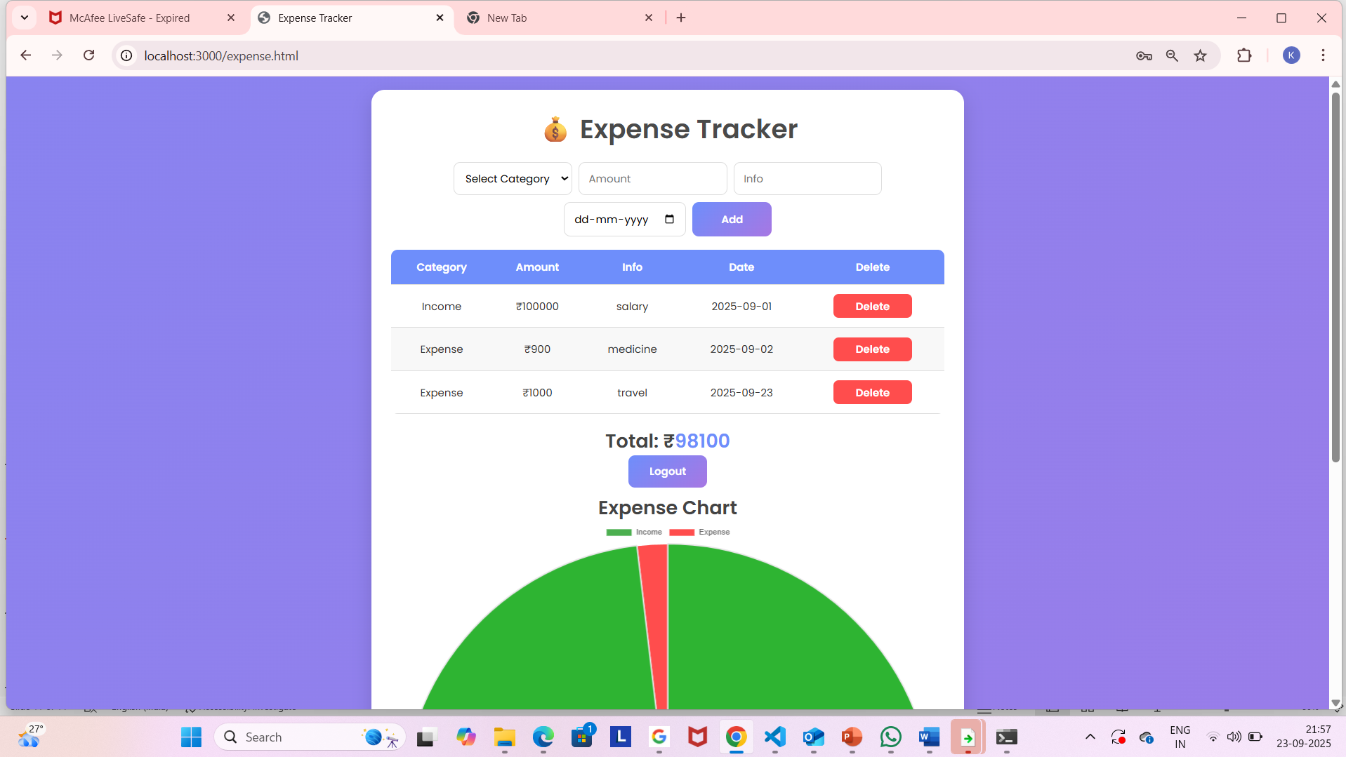

Slide 12
8. Workflow / Demo
Login / Signup
→Use enters credentials and logs in securely.
2. Add Expense
→Select category(Food, travel, etc), enter amount, date and description.
3. View expense list
→Shows all add expenses and incomes in a clean format.
4. Generate report
→There are pie charts for your incomes and expenses summaries.

Slide 13
Any Questions
“We are happy to clarify any doubts about our Expense Tracker project”

Slide 14
9. Conclusion
Our Expense tracker helps users easily manage and monitor their expenses.
The app is user-friendly, secure, and sufficient making daily expense management simple.

Slide 15
Thank You for your co-operating and supporting

